Slide 1

Data Analysis
Welcome to code world
Made by - vishal

Slide 2



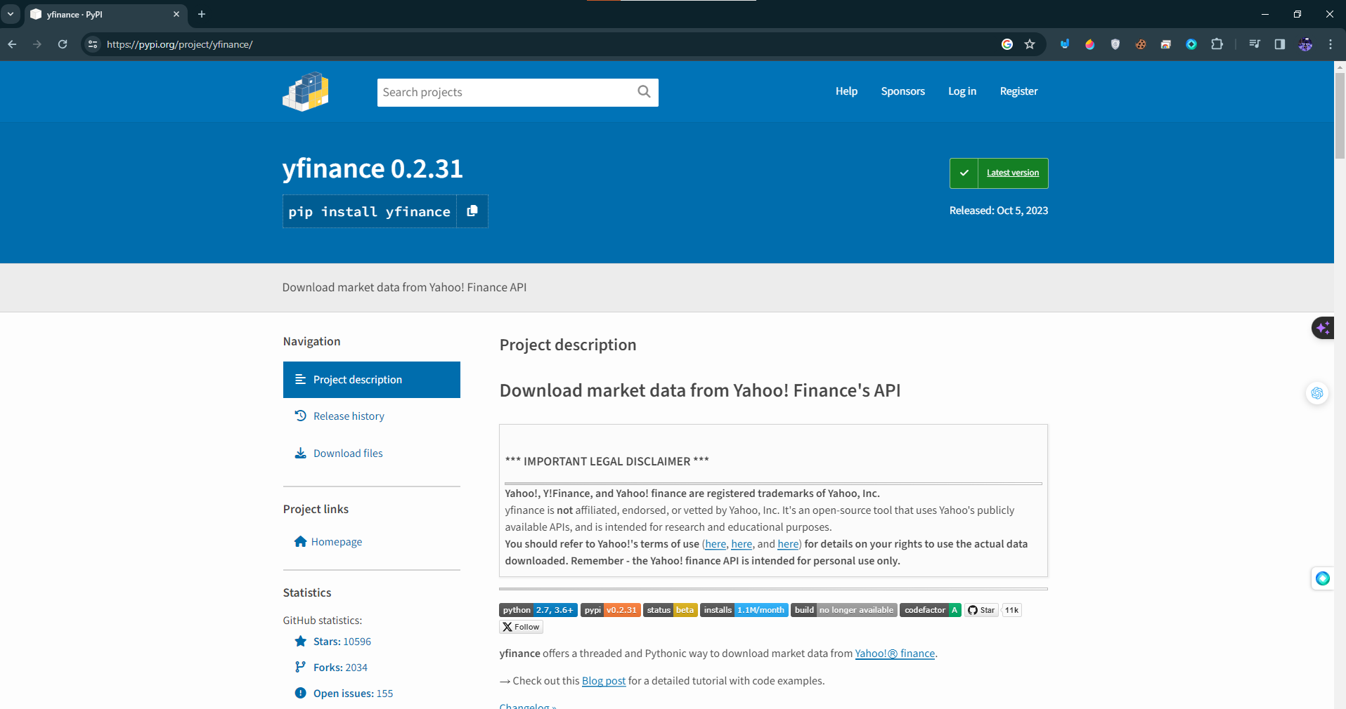

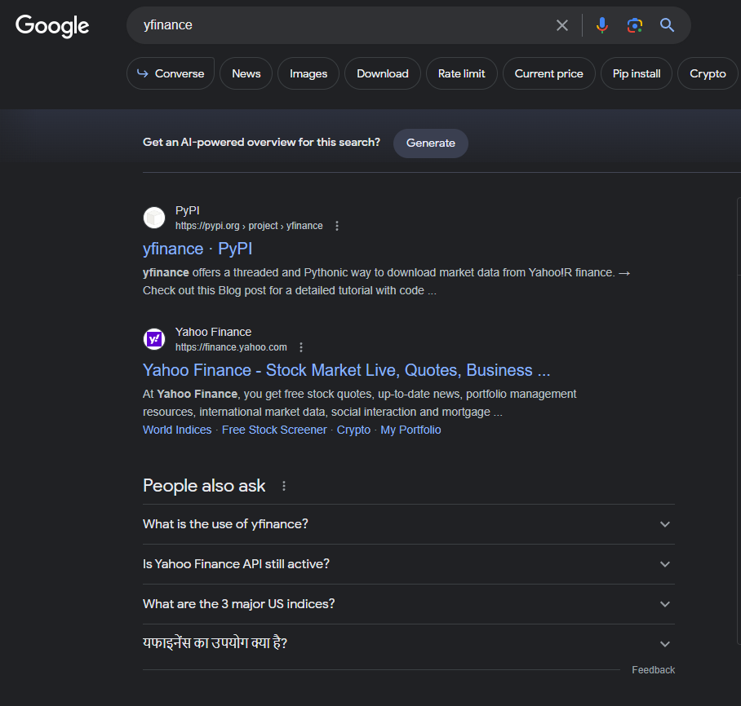
To install any package you can simply use CMD and type pip install and then package name
Example : pip install yfinance

Slide 3
Points that we going to Cover
How can we access Your desirable stock data ?
If I only want to see today and yesterday data ?
How can we get any custom date data for any stock ?
How can we see any company graph or performance chart with desirable date?
How can we compare any two company with graph?
How can show particular (Close,High,Volume and many more)?
How can I convert my live data into datafram for more flexibility?
How many days market is open ? With custom date ?
How can we compare two and more company with same graph?

Slide 4
To move forward we need to install Besi package to run our code smoothly.
import yfinance as yf
from datetime import date
from matplotlib import pyplot as plt
import pandas as pd

